Slide 1
Flowgraphs and Path Testing
Presented By
Trina Saha
Lecturer
City University

Slide 2
Goals of Testing
First goal is bug prevention
  No code to correct
  No retesting needed to confirm correction
  No one is embarrassed, no wreck of schedule
The second goal is bug discovery

Slide 3
Bug Prevention
Designing tests is the best method
Test-design thinking can discover and eliminate bugs at every stage in software development cycle
Thus Dave Gelperin and Bill Hetzel advocate “Test, then code”

Slide 4
Bug Discovery
Bugs are not always obvious
A test design documents expectations, test procedure, and the results of actual test
Knowing that a program is incorrect does not imply knowing a bug
Different bugs can have same manifestations, and
One bug can have many symptoms

Slide 5
What is Path-testing?
Path testing
  A name given to a family of test techniques that judiciously select a set of paths through a program.
Goal !!
  achieve some measure of test thoroughness.
Example
  Pick enough paths to assure that every source statement has been executed at least once.

Slide 6
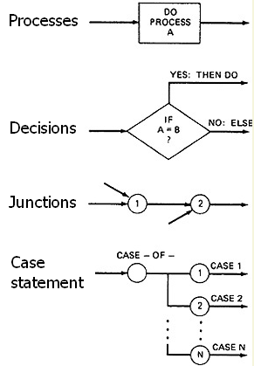
Control Flowgraphs
Control flowgraph / flowgraph is a graphical representation of a programs’ control structure
It uses
  Process blocks
  Decisions, and
  Junctions
It is similar to earlier flowchart but has some difference
Notes:
A process block can be one to many statements. From bugs point of view, once a process block is initiated, every statement within it will be executed. Junctions are like same entry point i.e. GOTO, END IF, CONTINUE etc.

Slide 7
Control Flowgraphs vs. Flowcharts
Control Flowgraph | Flowchart
Do not show the details of what is in a process block | Show the details. May have 100 boxes for 100 steps. There may be higher level of grouping concept, but no fixed rule
Ignores process steps | Flowchart focuses on process steps

Slide 8
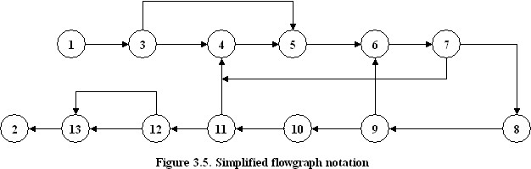
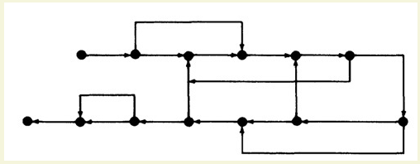
links
nodes
Link (7, 4)
Link (12, 13, upper) and (12, 13, lower)
Or simply use a unique lowercase letter for each link in the flowgraph
junction
decision
Figure 3.6. Even simpler flowgraph notation

Slide 9
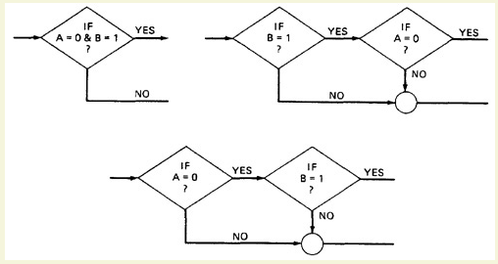
Alternate flowgraphs for same logic

Slide 10
Paths, Nodes and Links
Usually entry exit path
Path starts at an entry, junction, decision and ends at another
Path consists of segments
The smallest segment is a link
The length of a path is measure by number of links traversed
Not by the number of statements executed
Name of a path may be “(1, 3, 5, 6, 7, 8, 10, 11, 12, 13, 2)” or
“(1, 3, 4, 5, 6, 7, 4, 5, 6, 7, 8, 10, 11, 12, 13, 2)”
Loop

Slide 11
Fundamental Path Selection Criteria
Every decision doubles the number of potential paths
Every loop multiplies the potential paths
For a loop, each pass (once, twice, thrice, … ) constitutes a different path
Lavish test might consider all paths, but that would not be a complete test
  A bug could create unwanted paths or make mandatory paths un-executable

Slide 12
Complete Testing
Exercise every path from entry to exit.
Exercise every statement/instruction at least once
Exercise every branch and case statement, in each direction, at least once
If perception 1 is followed then perception 2 and 3 automatically followed
But perception 1 is impractical for most routines. Can only be done with routines that have no loops.
Perception 2 and 3 appear to be equivalent, but they are not

Slide 13
Static vs. Dynamic Analysis
Static Analysis
  Based on examining the source code or structure
  Can’t determine whether code is reachable or not
  Previous example, subroutine call with label parameter 100
Dynamic Analysis
  Based on code’s behavior while running
  Can determine whether code is reachable or not

Slide 14
Path Testing Strategies
Path Testing (P∞)
  Execute all possible paths i.e. 100% path coverage
  Impossible to achieve, strongest criteria
Statement Testing (P₁)
  Execute all statements at least once
  100% statement or node coverage, denoted as C1
  Weakest criteria
Branch Testing (P₂)
  100% branch or link coverage, denoted as C2
There are infinite number of strategies P₁, P₂, … P∞
But even that’s insufficient to exhaust testing
C₁ and C₂ are the minimum requirement

Slide 15
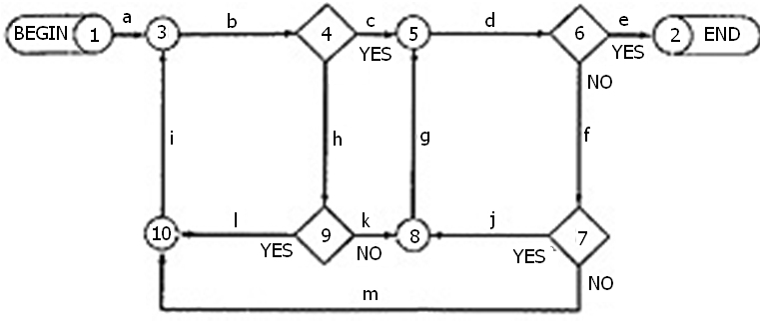
Which paths to select?
Pick up paths to achieve C1 + C2
Start at the beginning and take the most obvious path (1, 3, 4, 5, 6, 2) or (abcde)
Take the next most obvious path, abhkgde
Take a simple loop, preferably with previous path, such as abhlibcde
Then take another loop, abcdfjgde
Finally, abcdfmibcde

Slide 16
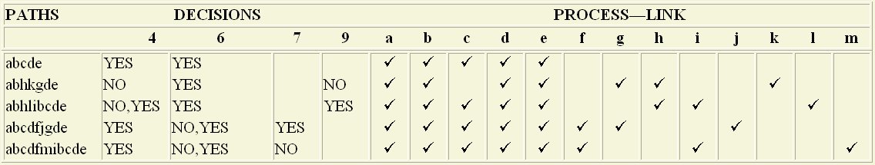
Which paths to select?
Continue selecting/choosing paths you appear to have achieved C1 + C2
We say, appear, because some of the path you selected might not be achievable.
As you trace the paths, create a table as the following
Check the following
  Does every decision have a YES and a NO in its column? (C2)
  Has every case of all case statements been marked? (C2)
  Is every three-way branch (less, equal, greater) covered? (C2)
  Is every link (process) covered at least once? (C1)

Slide 17
Suggestions to select paths
Pick the simplest, functionally sensible entry/exit path
Pick additional paths as small variations of previous paths.
Its better to have small paths, each differing by only one thing, rather paths that cover more but have several changes.
Cost of extra paths are few more microseconds of computer time.
Be comfortable with your chosen paths. Play your hunches and give your intuition free reign as long as you achieve C1+C2.
Don’t follow rules slavishly – except for coverage.

Slide 18
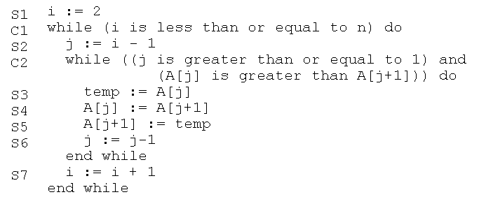
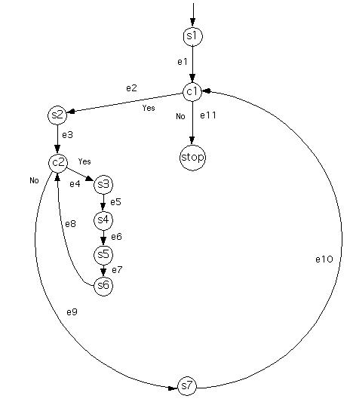
Path Testing Example
Sort an input array
Cyclomatic Complexity is 3
Three regions
N= 10, E = 11, E-N+2 = 3

Slide 19

Design of Tests
Skip the outer loop

Slide 20
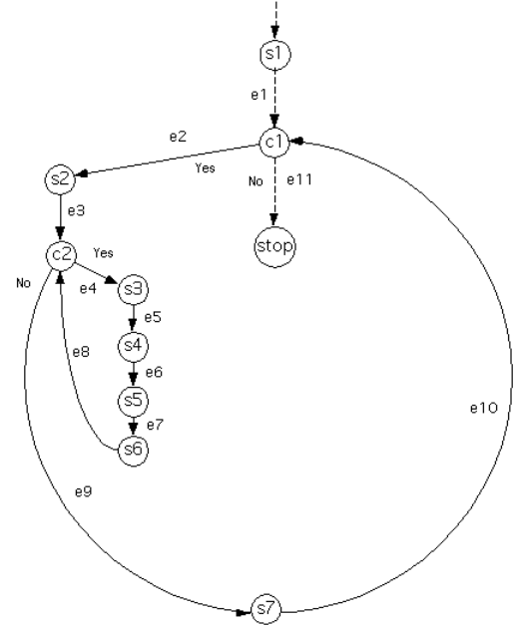
Design of Tests
Skip the outer loop
Dashed edges are covered

Slide 21
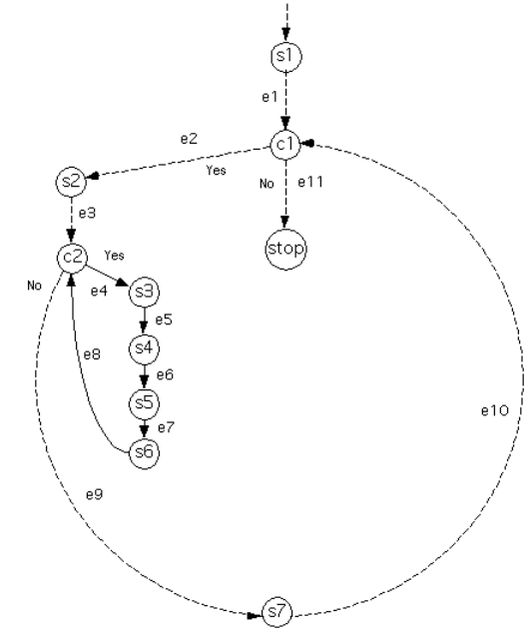

Design of Tests
Outer loop once
skip inner loop

Slide 22

Design of Tests
Inner loop once

Slide 23
Condition Testing
Path testing provides limited coverage
Condition testing much better coverage but complex
Three types of conditions
  Simple conditions
    A Boolean variable or application
  Relational Expressions
  Compound conditions

Slide 24

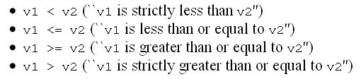
Relational Expressions and Compound Conditions
Comparisons of two values of same type
If the type is ``ordered'' then additional relational expressions are also possible
Combines simple conditions using logical connectives, such as and (&&), or (||), not (!)

Slide 25
Guidelines for Test Design
Boolean variables
  Test for true condition
  Test for false condition
Relational Expressions of ordered type
  Three tests, less than, equal, and greater than
Relational Expressions of unordered type
  Two tests, Equal and not equal

Slide 26

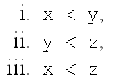
Guidelines for Compound Conditions
If complex condition connects k simple conditions with three cases, and h simple conditions with two cases, together.
Then, a total of cases
Some might be impossible to achieve, e.g.
impossible to achieve
So, check only the possible conditions

Slide 27

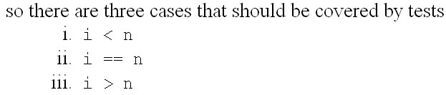
Application to an Example

Slide 28
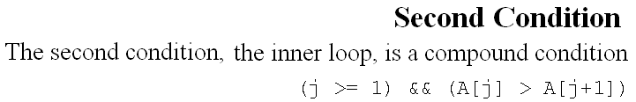
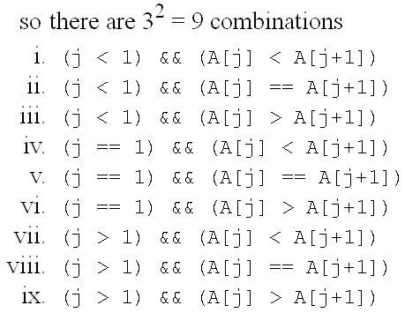
Application to an Example

Slide 29






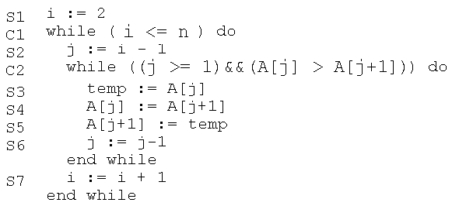
Cases Covered by Existing Tests
T2, T3
T1
T2

Slide 30
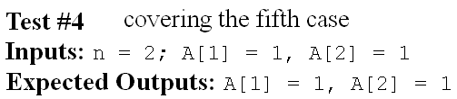
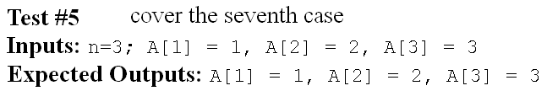
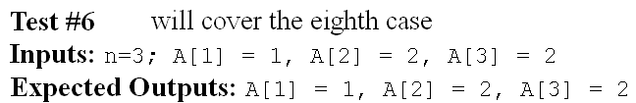
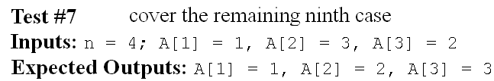
Cases Covered by Existing Tests
T2, T3
T1
T2

Slide 31
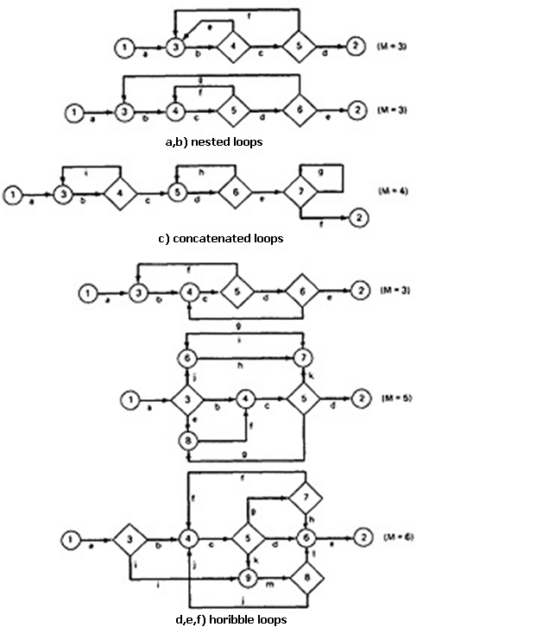
Loops
Three kinds:
  Nested
  concatenated
  horrible

Slide 32
Nested Loops
If you had five tests for one loop
  minimum, minimum + 1, typical, maximum – 1, and maximum
  assuming that one less than the minimum and one more than the maximum were not achievable
A pair of nested loops would require 25 tests
Three nested loops would require 125
This is heavy, reduce number of test cases

Slide 33
Nested Loops
Start innermost loop.
  Set all the outer loops to their minimum values.
  Test five cases minimum, minimum + 1, typical, maximum – 1, and maximum for the innermost loop
  Test for out–of–range and excluded values if necessary.
If done with outermost loop
  GOTO step 4, ELSE move out one loop, test five cases with all other loops set to typical values.
Continue outward until all loops are covered.
Do the five cases for all loops in the nest simultaneously

Slide 34
Nested Loops
Consequence
  Twelve tests for a pair of nested loops
  Sixteen for three nested loops
  Nineteen for four nested loops
  Data initialization problems are not identified
Huang’s twice-through theorem should also be applied for combination of loops
  Outer loops at the minimum, inner loop five cases
  Outer loop at one, inner loop five cases
  Outer loop at two, inner loop five cases
  Reverse the role of inner and outer loop, do again.

Slide 35
Concatenated Loop
Two loops are concatenated if they are on the same path
Even if on the same path and they are independent of each other, treat them as individual loops
Other wise treat them as you would nested loops.

Slide 36
Loop Testing Time
It can take long testing time if MAX is higher and we attempt (MAX-1, MAX, MAX+1).
  Three nested loops with limits 10000, 200, 8000, a total of 16,000,000,000 iterations.
  You can test for 100, 20 and 80
  Avoid rescaling 2, 4, 8, specially 256, 65536 i.e. binary powers; peculiarity of the numbers may mask a bug
Notes:
Bugs are not related with the numbers. If bug is there it would show with range of 100, 20, 80.
If large time requires then it probably specification error, or show that this combination will not occur in reality.

Slide 37
Effectiveness of Path Testing
Approximately 65% of all bugs can be caught
Path testing is more effective for unstructured than for structured software

Slide 38
Limitations of Path Testing
May not cover if you have bugs, totally wrong or missing functions.
Interface errors, i.e. interface with other routines
Database and data–flow errors
  The routine can pass all of its tests at the unit level, but the possibility that it interferes with or perturbs other routines cannot be determined by unit–level path tests.
Not all initialization errors are caught by path testing.
Specification errors can’t be caught.

Slide 39
A Lot of Work?
Creating flowgraph, selecting covering paths, finding input data, setting up loop cases and combinations.
But the fact is
  The act of careful, complete, systematic, test design will catch as many bugs as the act of testing.
  The test design process, at all levels, is at least as effective at catching bugs as is running the test designed by that process.
bugs caught during test design cost less to fix than bugs caught during testing

Slide 40
Tricks to do it
but you can do it from source code
Make several copies of source code
Mark the path with a yellow pen

Slide 41
References
Chapter 3, Software Testing Techniques - Boris Beizer

